Slide 1

DISTRACT FREE GEEK
A PROJECT PRESENTATION ON:

Slide 2
Project submitted by:
Prajjwal Srivastava- 201500489
Rishabh Rastogi- 201500567
Rohit Saxena- 201500590
B.Tech CSE IIIrd year Students
GLA UNIVERSITY

Slide 3
Acknowledgement
A successful work is always raised by many hands:
We are thankful to the :
CSE Department
Mohd.Amir Khan
(Tech. Trainer,CSE Dept.)
All faculties and our Friends

Slide 4
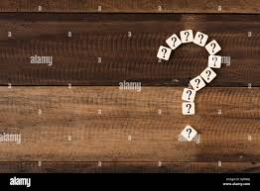
WHY THIS IDEA?
FOR FUTURE SCOPE:
TO TARGET MAXIMUM AUDIENCE & CAN GET REAL TIME FEEDBACK
TO SOLVE A DAY-TO DAY LIFE PROBLEM
VISION TO TARGET IT AS A MAJOR PROJECT TOO

Slide 5
AFTER A LONG DISCUSSION !!!
IT’S A EUREKA!!!!!!!!!
LETS “ BUILD A DISTRACT FREE GEEKY ENVIRONMENT”

Slide 6
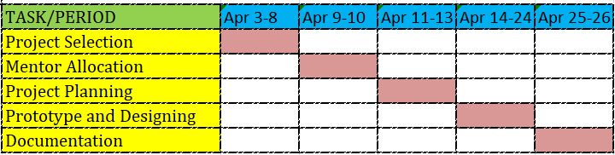
HOW WE PROCEED?

Slide 7
BASIC IDEA OF THE PROJECT
CREATING ACCOUNT
SIGN IN
WATCHING VIDEOS
GETTING PERFORMANCE GRAPHS
FEW ADDITIONAL FEATURES

Slide 8
LETS SEE WHAT WE HAVE IN THE PROJECT!

Slide 9
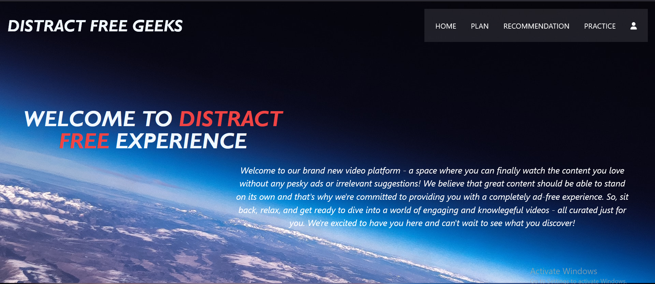
WELCOME PAGE

Slide 10
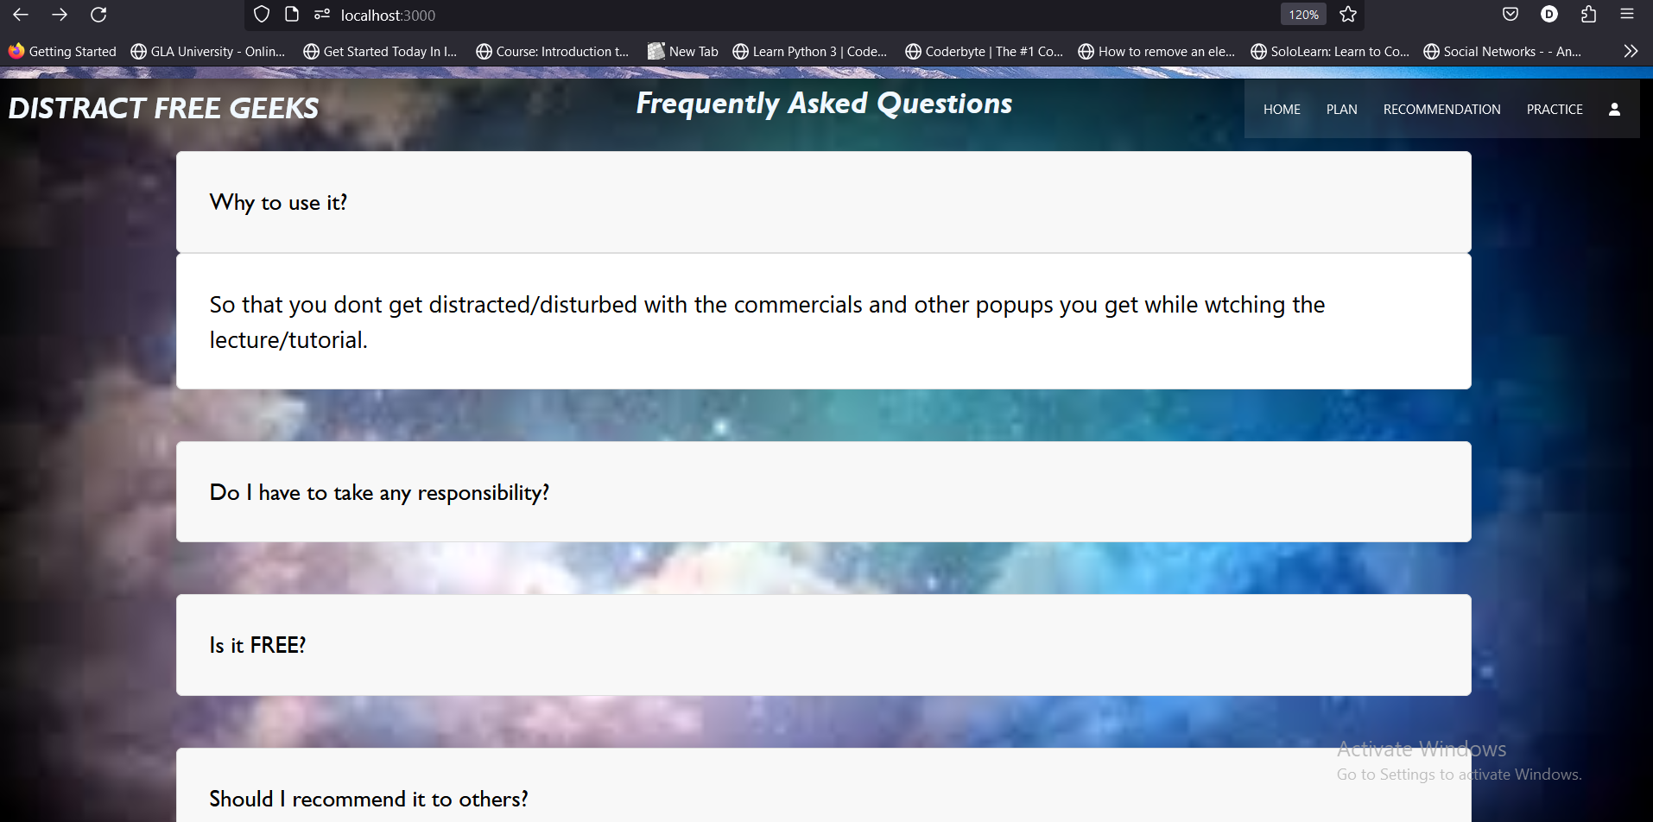
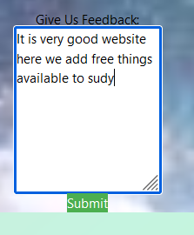
Frequently Asked Question

Slide 11
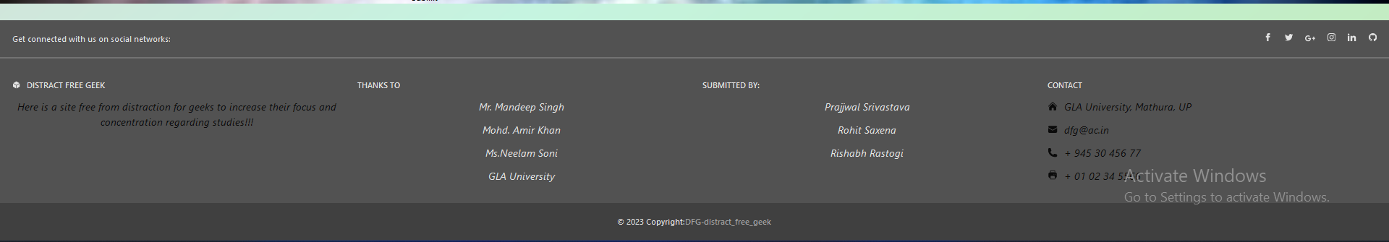
footer
LINKS TO PROFILES

Slide 12
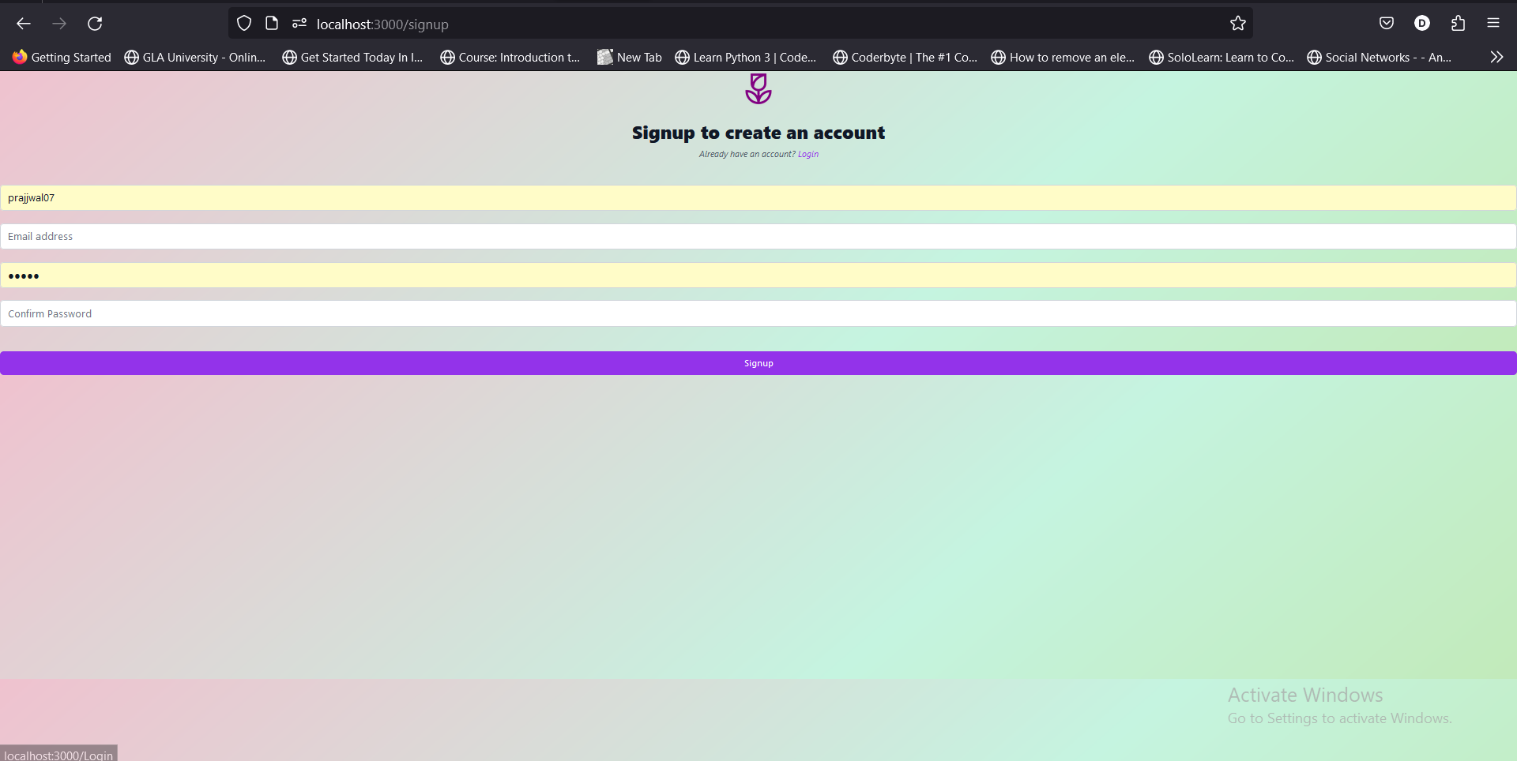
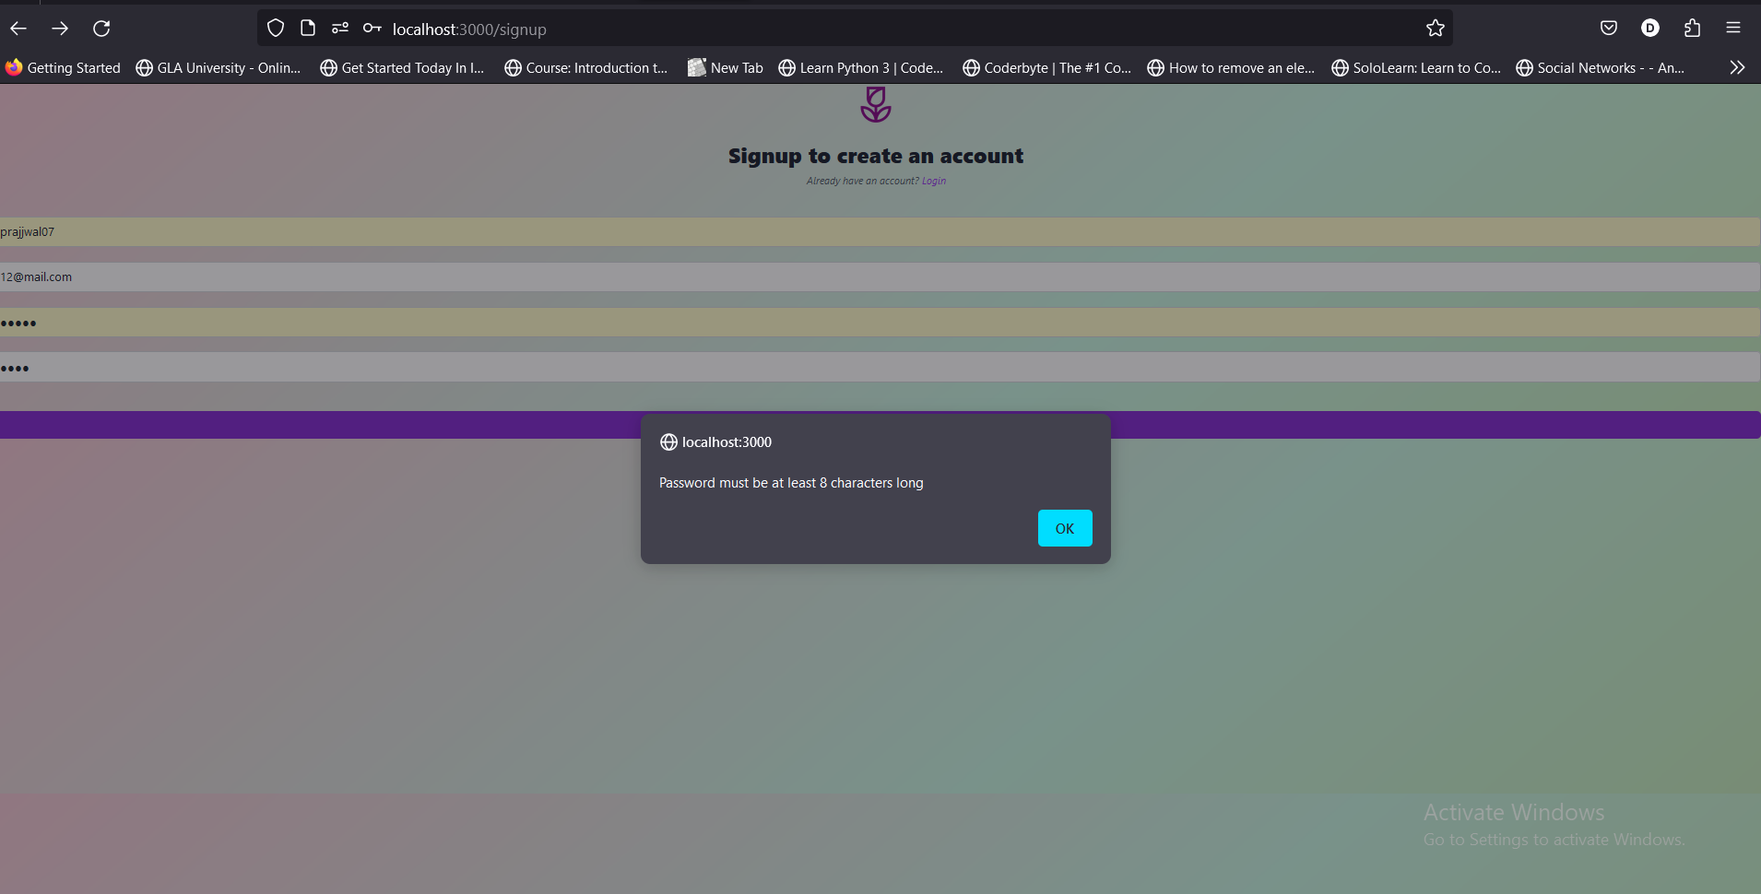
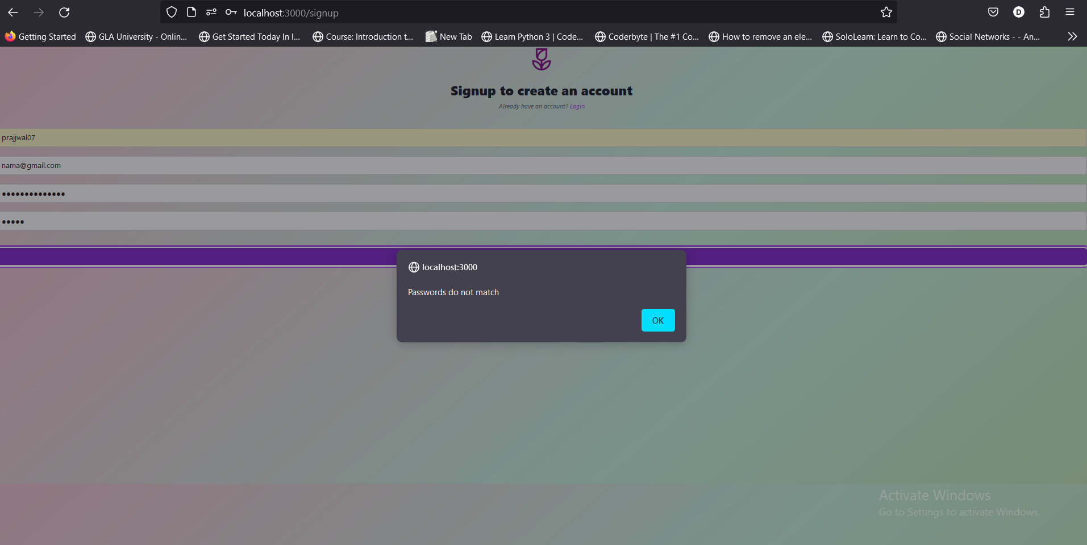
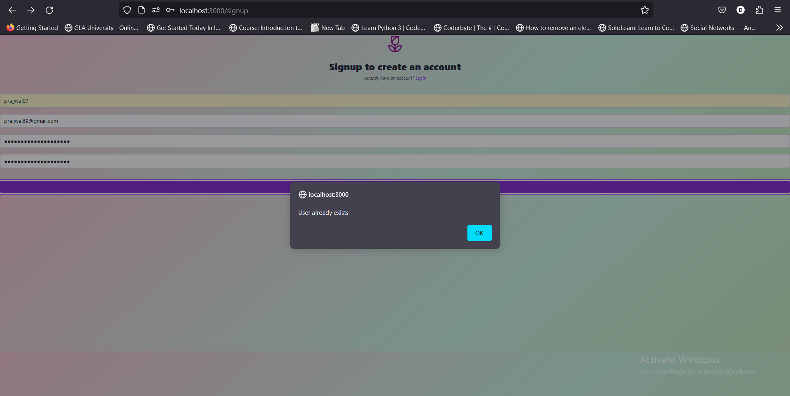
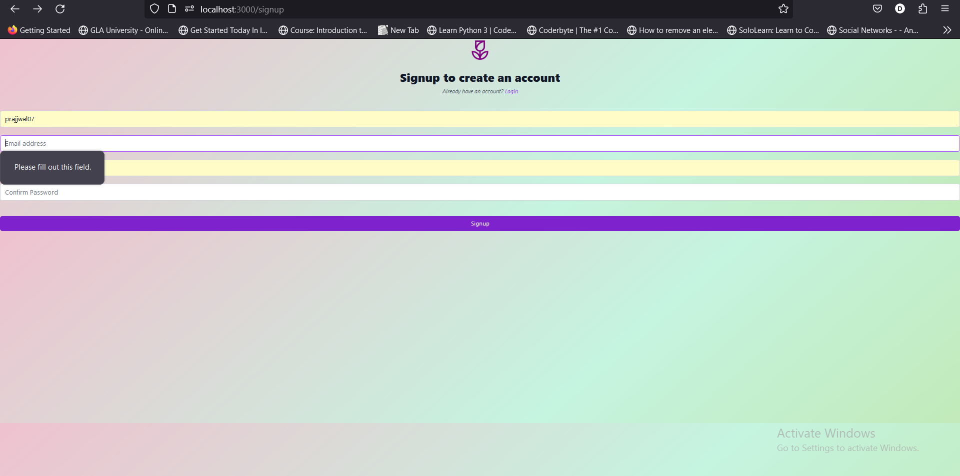
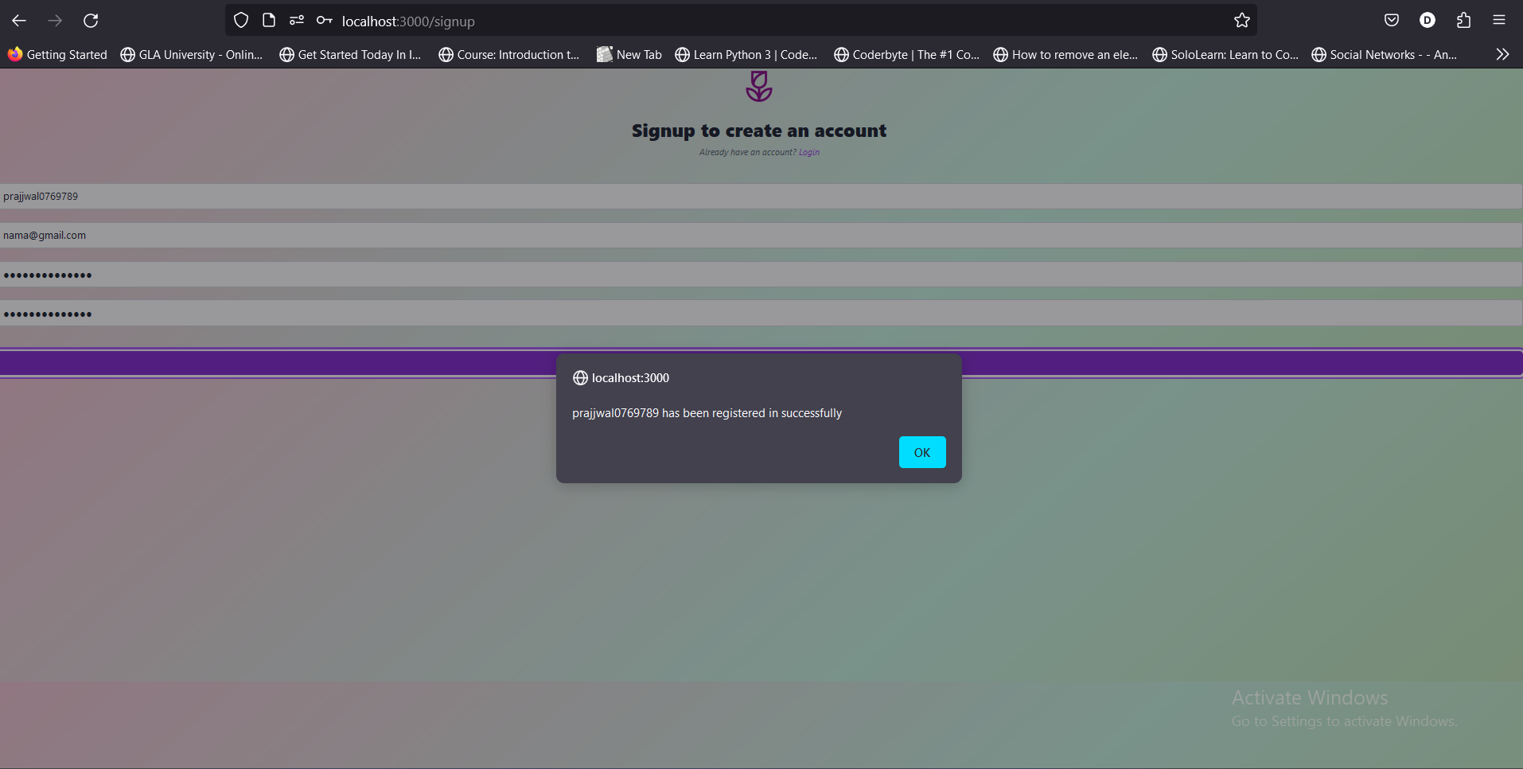
SIGNUP PAGE
Leaving empty fields

Slide 13
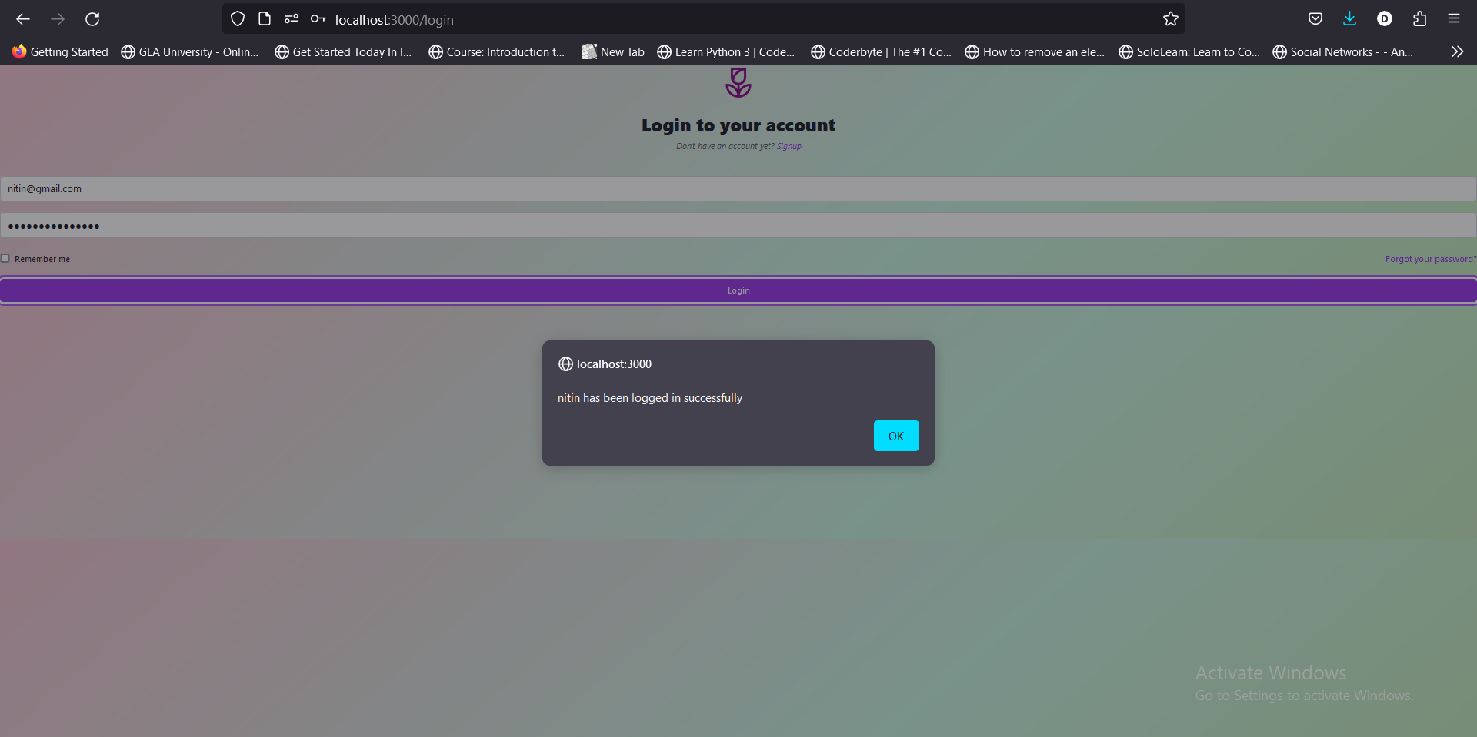
Login Page

Slide 14
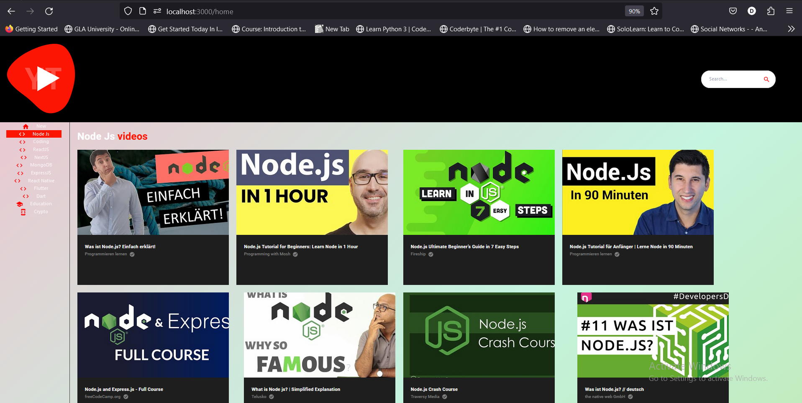
Home page
Back Button
Search Bar
Category Panel

Slide 15
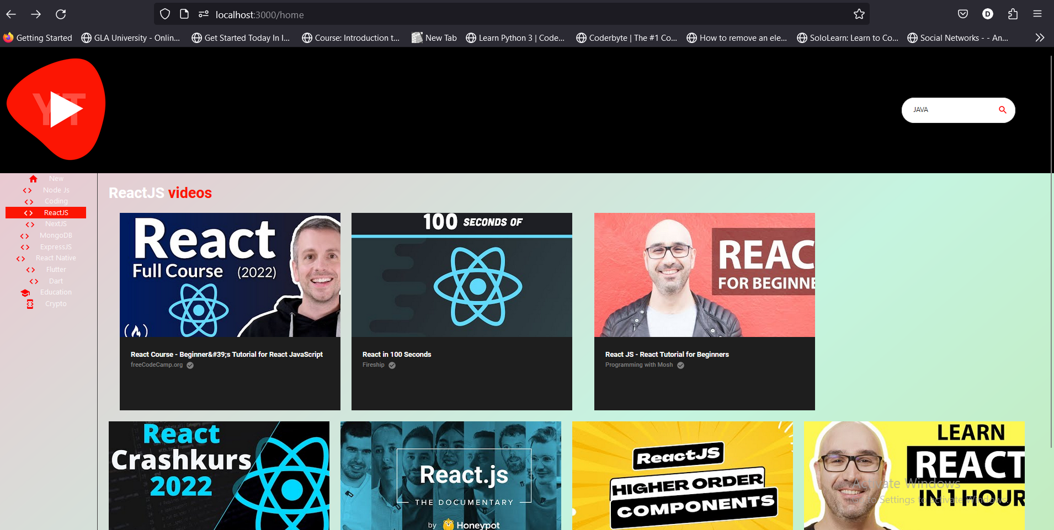
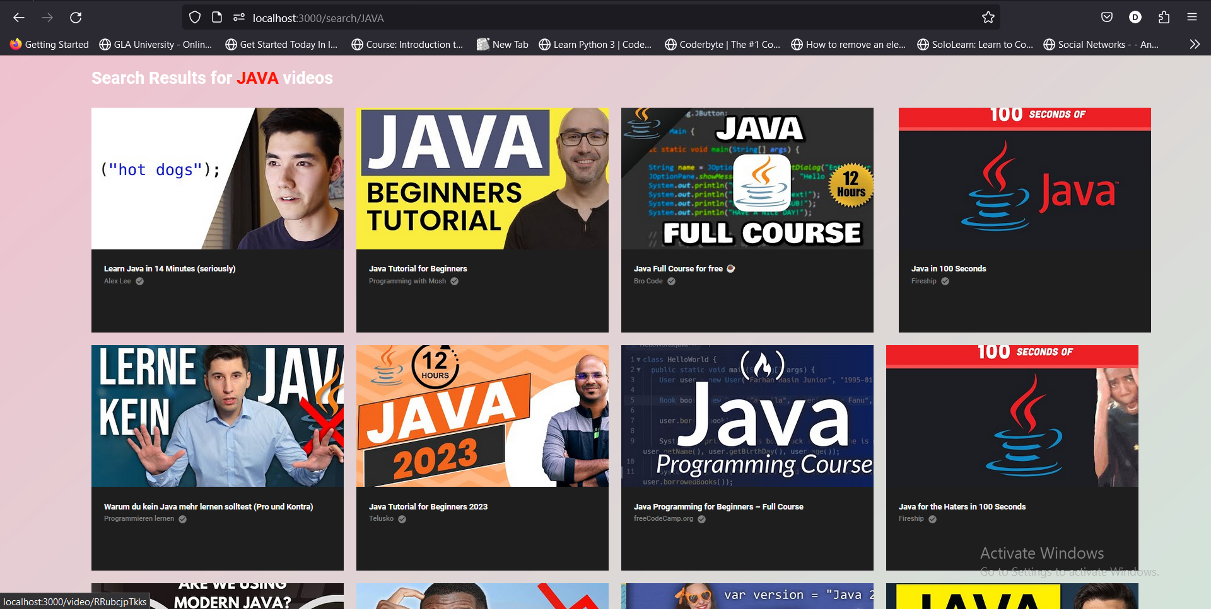
SEARCH BAR

Slide 16
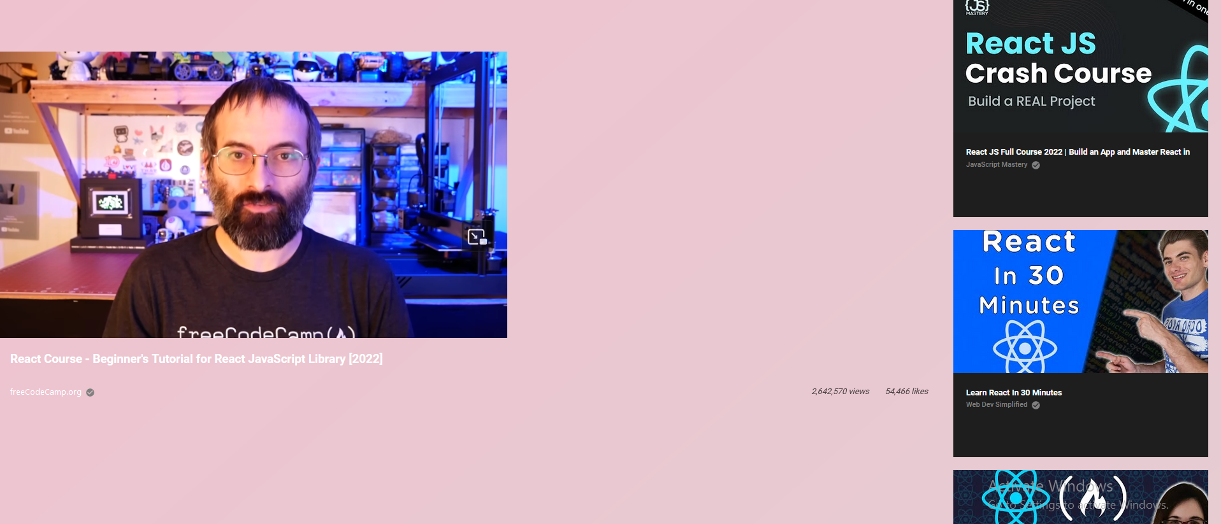
VIDEO PLAYING
VIDEO PLAYING
RECOMMENDATION
CLICK ON CHANNEL PAGE

Slide 17
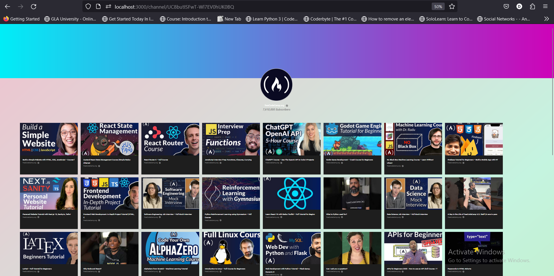

Slide 18
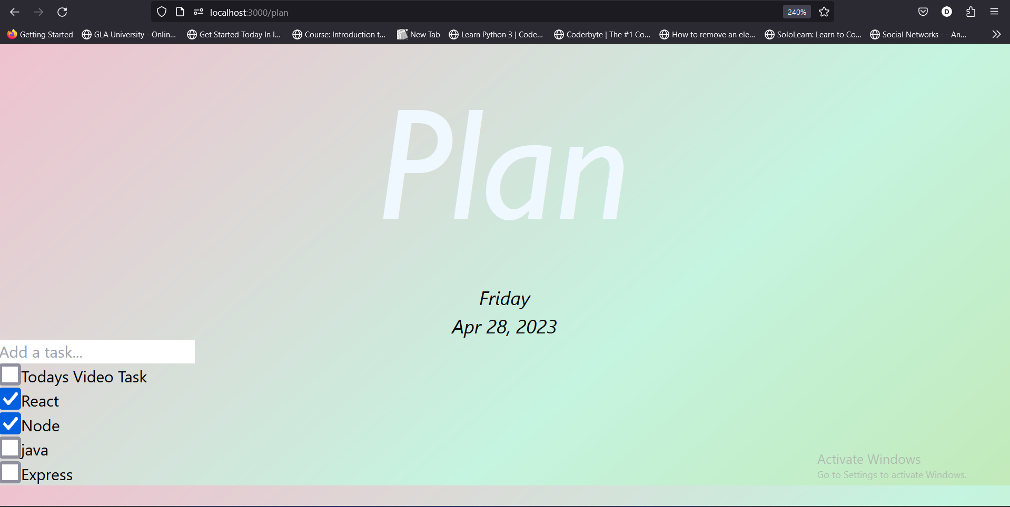
PLAN PAGE

Slide 19
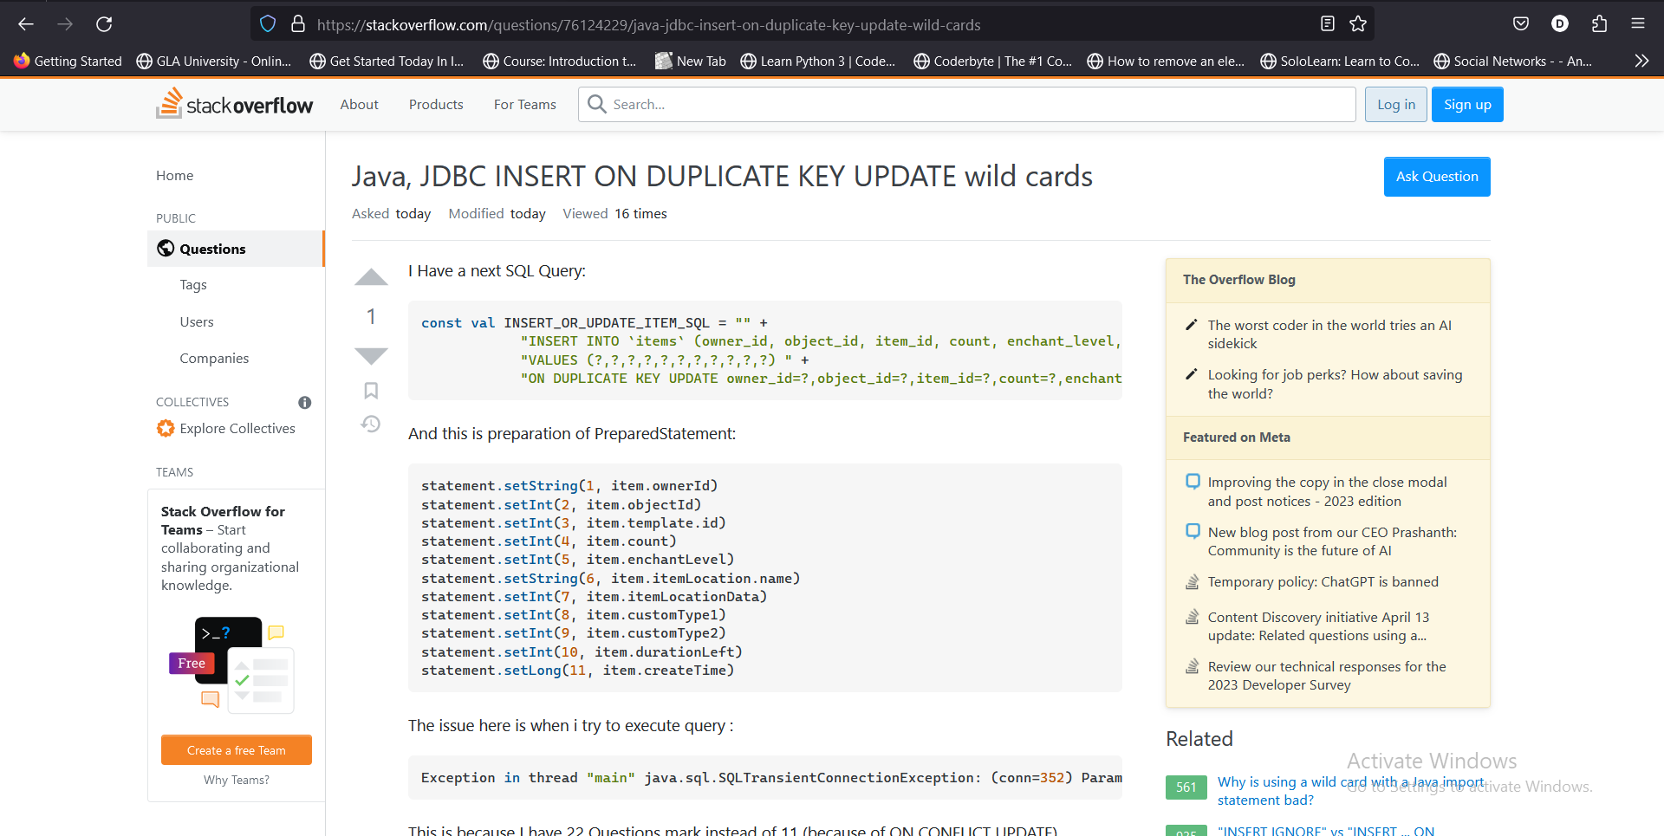
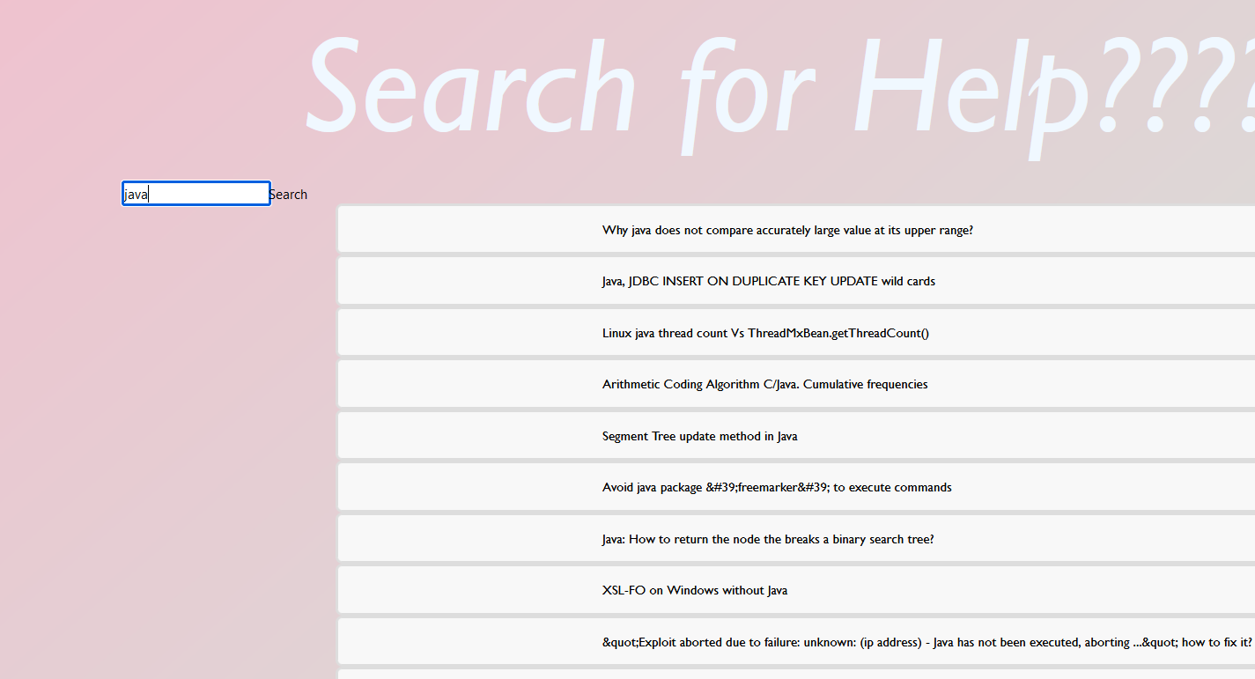
RECOMMENDATION PAGE
Click on search button and get the links

Slide 20
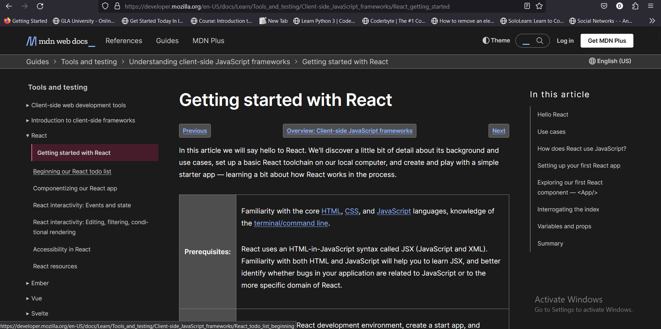
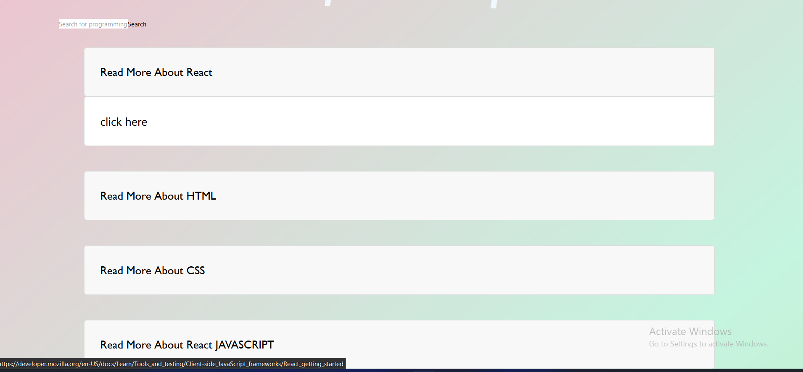
Recommendation page

Slide 21
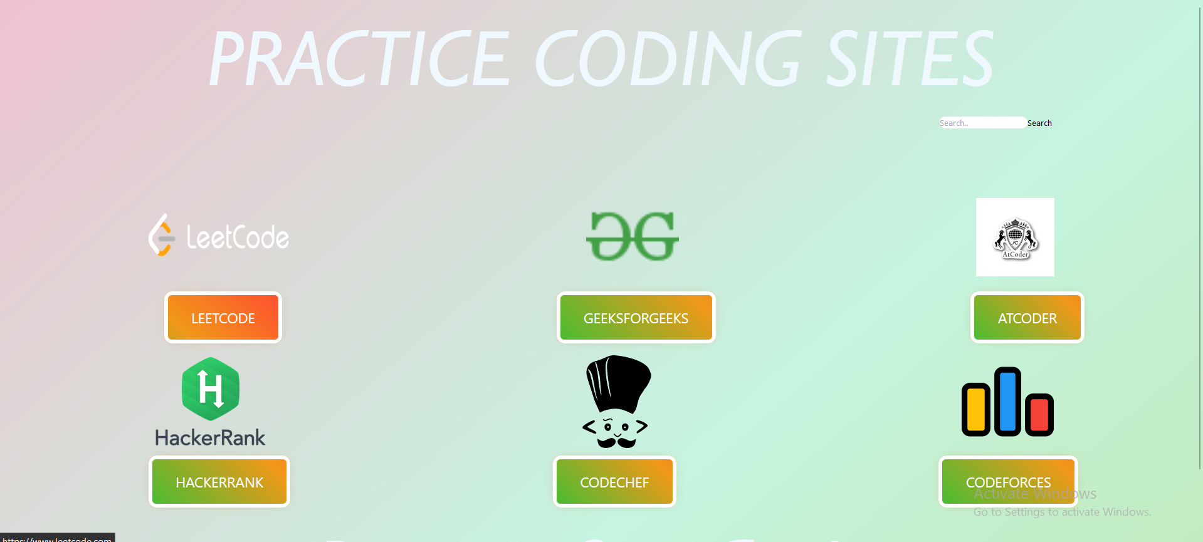
Practise page
REDIRECTED TO GOOGLE—FOR ANY QUERY
CLICK ON THESE

Slide 22
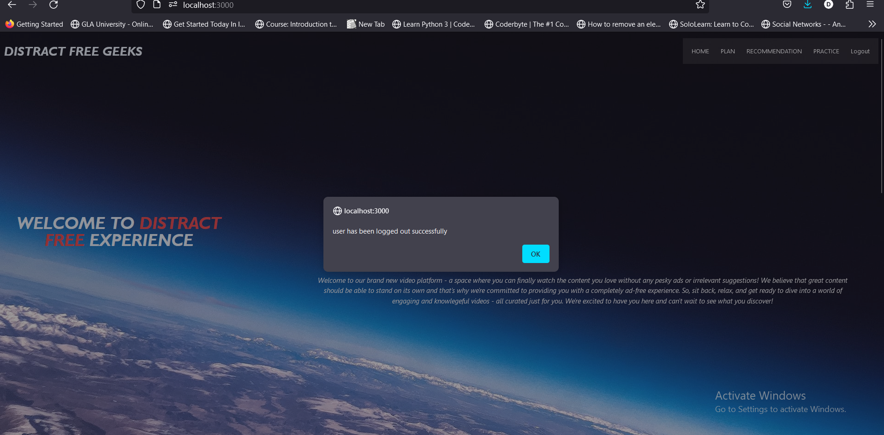
logout

Slide 23
FUTURE WORK
We welcome suggestions for the project!!!
Associate payment gateway links.
History sections.
Forgot password option will be added.

Slide 24

Thankyou
LETS GO THE LIVE DEMONSTRATION OF THE PROJECT

